Slide 1
Office 365 Login Instructions

Slide 2
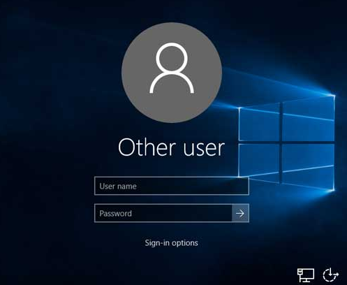
Step 1: Login with Student ID & Generic Password
*For Blended Learning devices, username should be entered as MCSK12\student123456

Slide 3
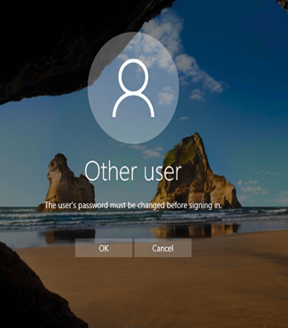
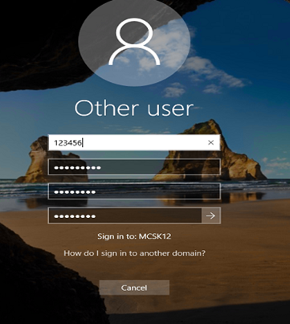
Step 2: Change password to STUDENT BIRTHDAY (DOB)
Old
Student: John Jones
User ID: 123456
Password: Password1
New
Student: John Jones
User ID: 123456
Password: 01102005

Slide 4
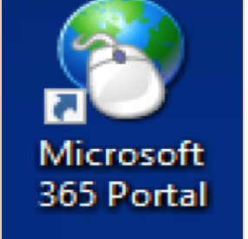
Step 4: Once logged in, click on the following desktop icon

Slide 5
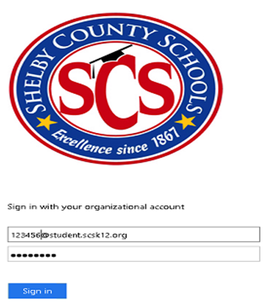
Step 5: Login with student’s Username and PW
*Example: 123456@student.scsk12.org & 11202000

Slide 6
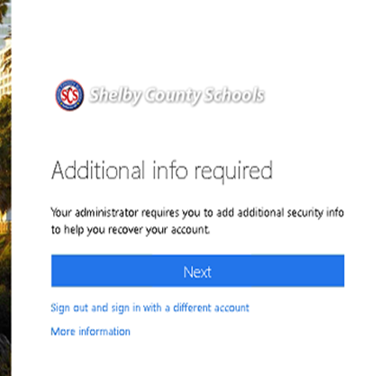
Step 6: After signing into organizational account, you will be asked to input addition information
*Click NEXT

Slide 7
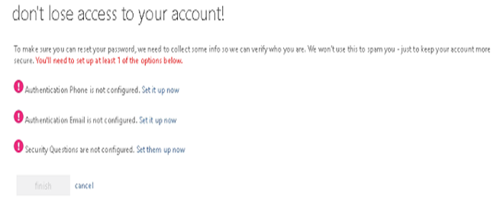
Step 7: Select Security Questions not configured … Set them up now

Slide 8
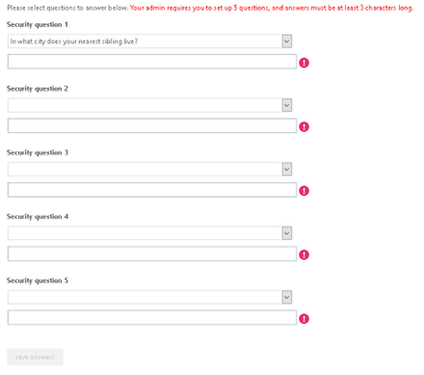
Step 8: It is RECOMMENDED to ask STUDENTS to choose questions that they can provide REAL answers that they can remember
*After answering questions, click save answers and finish

Slide 9
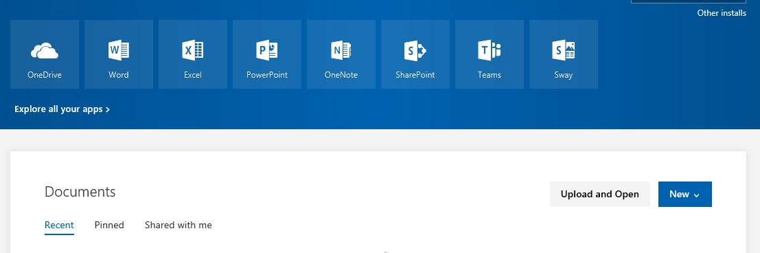
Step 9: The following screen will appear:

Slide 10
Step 10: You have successfully logged into a student’s Office 365 account. Enjoy!

Slide 11

Please email Deploymentservices@scsk12.org with any questions, comments or concerns AFTER you have followed the above steps.

